Slide 1
ASE 239
Presentation Assignment

Slide 2
Part 2 – Audience Description
My audience is a group of Computer Engineering students, studying at NAIT. They might be interested in hearing some different ideas. I am hoping that they will maintain an open mind throughout the presentation, because my topic is very controversial.

Slide 3
Part 3 – Add Headings to Your Presentation
You can review the headings by switching to Outline view on the left
Submit this PowerPoint with the headings for your completed presentation

Slide 4
What is a Flying Spaghetti Monster?

Slide 5
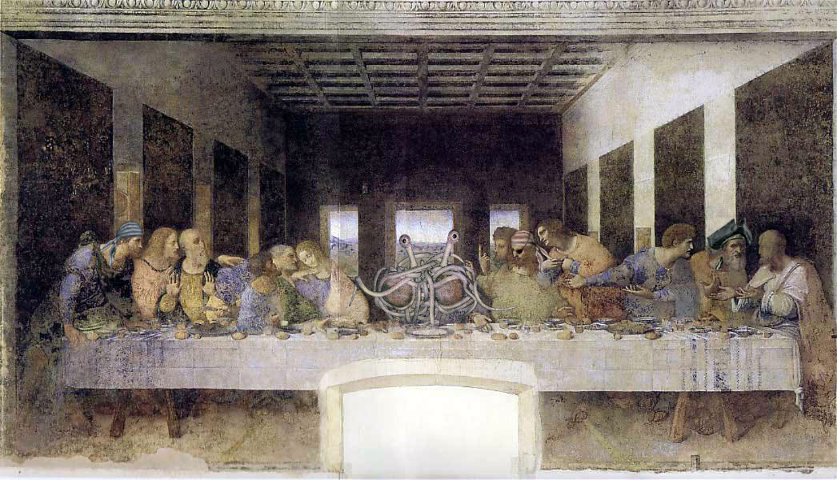
What is a Flying Spaghetti Monster?

Slide 6
What is a Flying Spaghetti Monster?

Slide 7
General Information About Pastafarianism
We believers choose to be identified as Pastafarians.
  This is mainly because spaghetti is a pasta.
Our story of creation is slightly different then what most people are familiar with.
  In the beginning, there was nothing.
  Then, He created a mountain, some trees and finally, a midget.

Slide 8
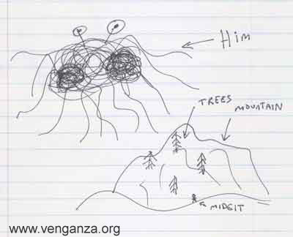
General Information About Pastafarianism

Slide 9
General Information About Pastafarianism
I have located a short video describing the creation of the earth.
  It can be seen at:
    http://www.venganza.org/2006/11/07/fsm-animation.htm

Slide 10
General Information About Pastafarianism
We Pastafarians also believe that the lack of pirates in modern times is a direct cause of global warming.
  FSM loves pirates. Because of a lack of pirates, he becomes very angry and hot. Since His Noodley Appendage is always touching all of us, this heats the earth.
I have a graph to demonstrate this relationship:

Slide 11
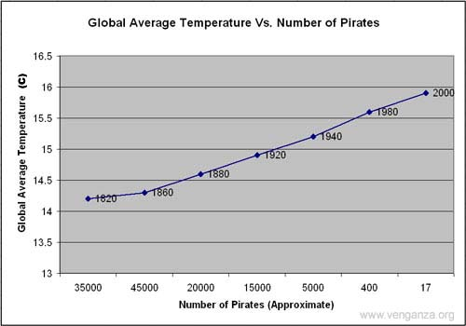
General Information About Pastafarianism

Slide 12
What Does FSM Mean To Me?
FSM performs various random miracles
  He does this using His Noodley Appendage
  When you receive a miracle, it is said that you have been “touched by His Noodley Appendage”

Slide 13
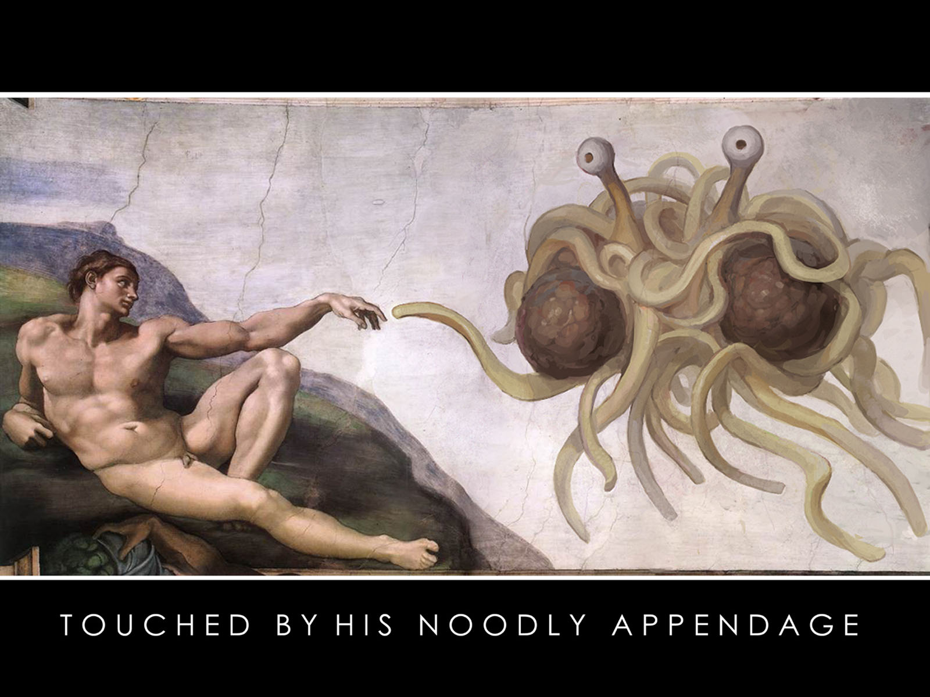
What Does FSM Mean To Me?

Slide 14
What Does FSM Mean To Me?
Our heaven is also different then the Christian heaven.
  We have a stripper factory and a beer volcano
    The factory also produces male strippers for the ladies
  This makes our heaven much cooler then the Christian version
  When you die would you rather a plain old boring heaven? Or do you want to get drunk and watch strippers all day?

Slide 15
Evidence And Testimonies

Slide 16
Part 4 – Complete the assignment
Add content to the slides that you have created headings for
Arrange the slides and graphics in a logical order
Apply a Slide Design (Format – Slide Design and select a suitable slide template)

Slide 17
Citations and References
Slide 8 & 11 images:
  Henderson, Bobby. "Open Letter To Kansas School Board." Church of the Flying Spaghetti Monster. 14 Sept 2006. 9 Nov 2006 <http://www.venganza.org/about/open-letter/>.
Slide 4 image:
  9 Nov 2006 <http://www.venganza.org/images/wallpapers/Last-Supper.jpg>.
Slide 13 image:
  9 Nov 2006 <http://www.venganza.org/images/wallpapers/noodledoodle1600_1200.jpg>.

